Slide 1


Project Staker
Team Mforce
Ryuto Kimura
James Ballard
Jacob King
Nick Creecy
Bryn Welch

Slide 2
Elevator Pitch
A 4 player co-op game for PC where you must survive the estate of a long-dead Count with only a torch and three eccentric companions.

Slide 3
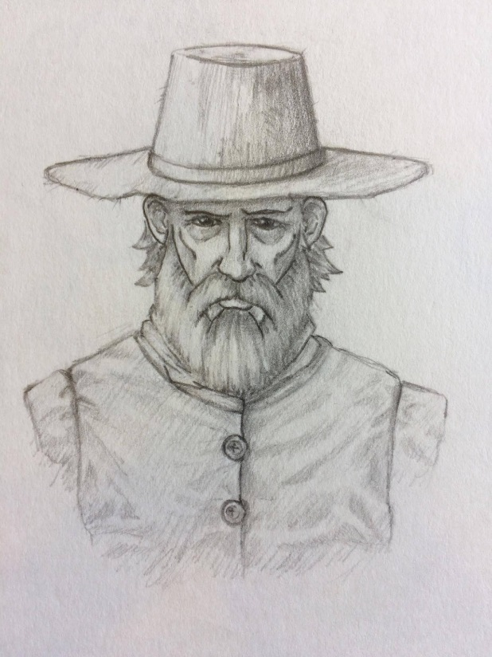
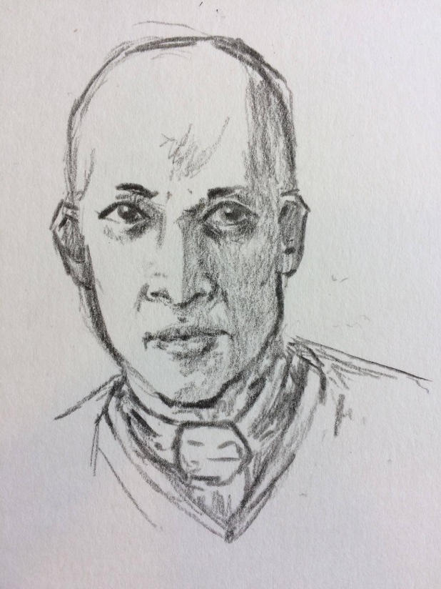
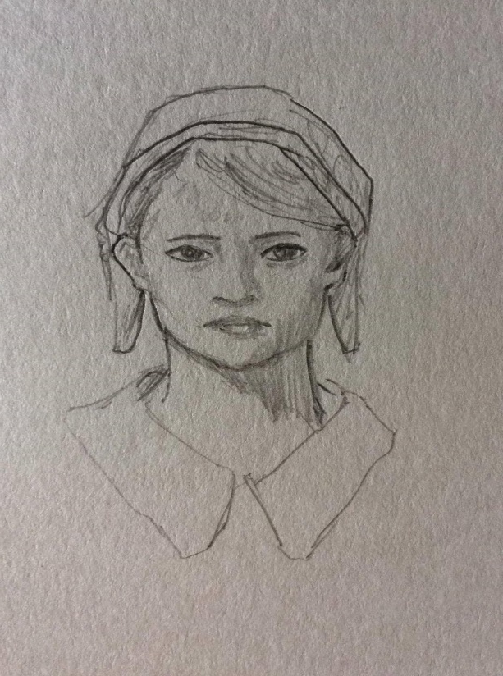
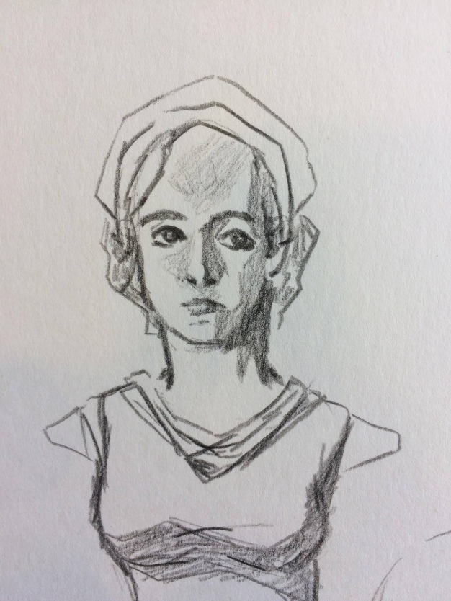
The Characters
Pride
Redemption
Revenge
Righteousness

Slide 4
User Journey
Game Startup
Main Menu
Tutorial or Play Online
Steam Lobby
Accept Invite
Join Lobby
Select Map
Ready Up
Play

Slide 5

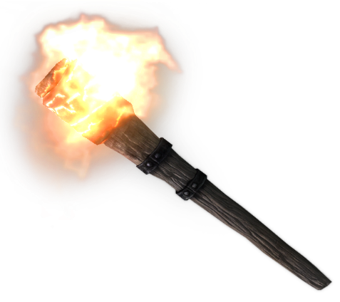

Core Loop
Enemy Spawnpoint Appears
Burn It Away
Make Progress

Slide 6
Enemies & Level Obstacles
EXPLORE, STALK, ATTACK, FLEE
BLOODLUST & HATRED
LEVEL OBSTACLES

Slide 7
Prototype

Slide 8
Technical Challenges

Slide 9
Art Style
Notes:
SLIDE EXIT: And now that you’ve (hopefully) got a good picture of the game in your heads…

Slide 10
Marketing
UNDERSERVED GENRE
Left 4 Dead, Resident Evil, Dying Light
UNIQUE MARKET POSITION – ENDURING THEME
Yearly vampire films, few vampire games.
STANDARD PRICE POINT
Competitor pricing at $20.
Notes:
Let’s talk about marketability.
UNDERSERVED GENRE: The last significant content update for extremely successful competitor game Left 4 Dead 2 was six years ago. Resident Evil 7 ditched the co-op element from the last three games in favor of a refined single-player experience. Dying Light’s co-op was not the primary focus of the game.
UNIQUE MARKET POSITION: Don’t check off your bingo cards just yet, (ladies &) gentlemen. I’ve got justification. Every year for the past century at least one film has been produced containing vampires – Traditional vampires, not the sparkly ones – as a horrific figure.

Slide 11
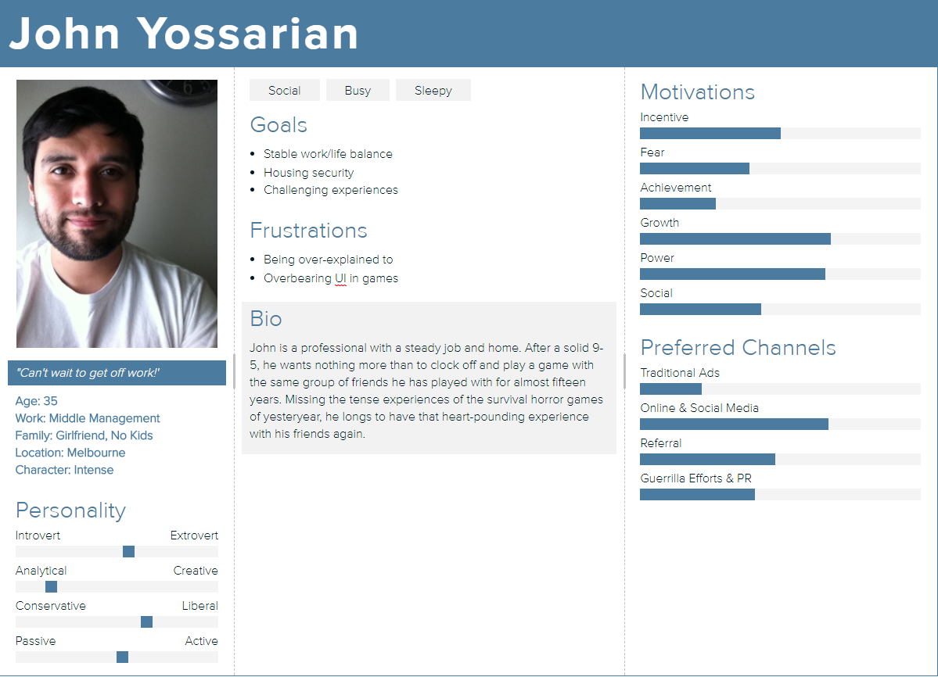
Personas

Slide 12
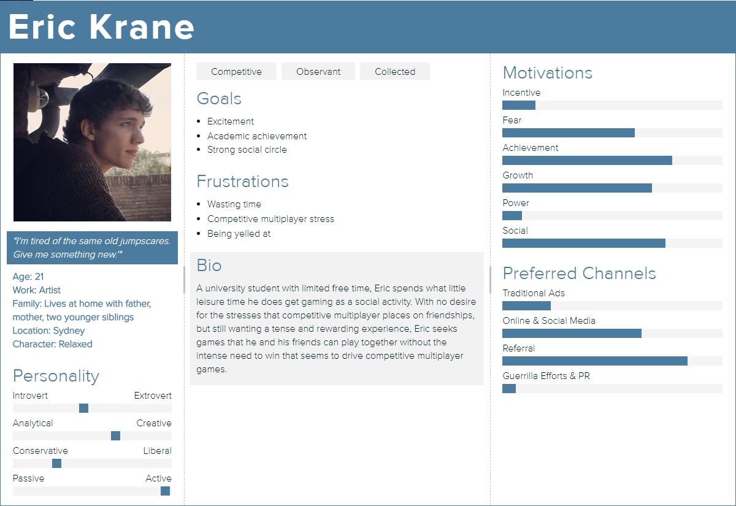

Slide 13
Production Schedule
ALPHA
Art: Characters
Particles
Environment Assets
Mixamo Anims
Programming: Enemy AI
Character Controllers
Enemy Spawning
LAN Networking
Design: Level Audio Recording
Level Design
Functionality Testing
Mechanical Iteration
BETA
Art: Full Texturing
Custom Animations
Programming: AI
Level Scripting
Feedback Systems
Audio Implementation
LAN Networking
Design: Bug, Functionality, & User Testing
Level Design Iteration
Mechanical Iteration
GOLD
Art: Polish
Catch-Up
Hit Feedback Particle Effects
Programming: AI
Feedback Systems
Audio Implementation
LAN Networking
Design: User & Bug Testing
Level Design Iteration
Notes:
For this 14 week production cycle, this is what we will be aiming to deliver by gold. It will not be a complete game, instead being a very polished vertical slice showing off the core gameplay, at which point we can choose to seek further funding while starting a marketing campaign with our product.
You may have noticed that characters will not be voiced in this 14 week production cycle. Voice talent and studio time is expensive, and the game can be assessed as a viable product without it.

Slide 14
Budget

Slide 15
Contingency Plan
The Chopping Block
Level Obstacles
Scripted Levels
Multiple Levels
Why Not Multiplayer?

